Slide 1


React App Development Update
Good morning, everyone. Today, I’ll be presenting the progress we’ve made on our project: a React-based application with a backend built using Spring Boot and a Postgres database. Our app currently has two main features: secure user authentication and authorization, and a basic task management system. We’re also working on a mobile version specifically designed for managers, which will have limited functionalities for now. I’ll also touch on our plans to add file upload capabilities and other future enhancements.
by Andra-Maria Mihut

Slide 2
Feature 1: Secure Authentication and Authorization
JWT Authentication
Role-Based Access
When a user logs in, the backend validates their credentials and generates a JWT that contains their user information and roles. The JWT is sent to the client and stored (in localStorage or cookies).
For subsequent requests, the JWT is included in the authorization header, allowing the backend to validate the user’s identity and permissions securely without querying the database repeatedly.

Slide 3
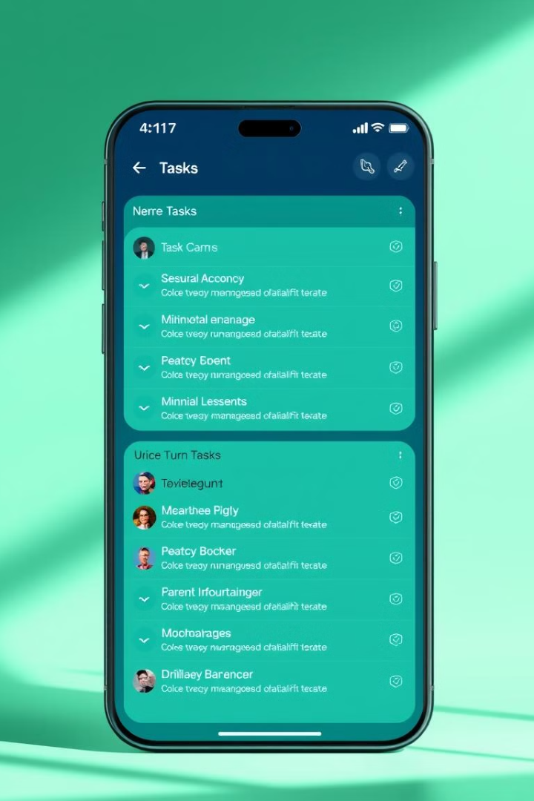
Feature 2: Task Management System
Task Retrieval
Task Creation
The backend uses Spring Data JPA to interact with the Postgres database and has an endpoint (GET /tasks) to fetch all tasks.
Another endpoint (POST /tasks) allows new tasks to be added.
Frontend Interaction
In React, tasks are displayed in a list fetched from the backend, and a form component handles task creation.

Slide 4



Mobile App Progress
Manager-Focused
Cross-Platform Compatibility
The mobile app is being developed specifically for managers and will have limited functionalities compared to the web app.
Built with React Native, ensuring a seamless user experience for managers.

Slide 5
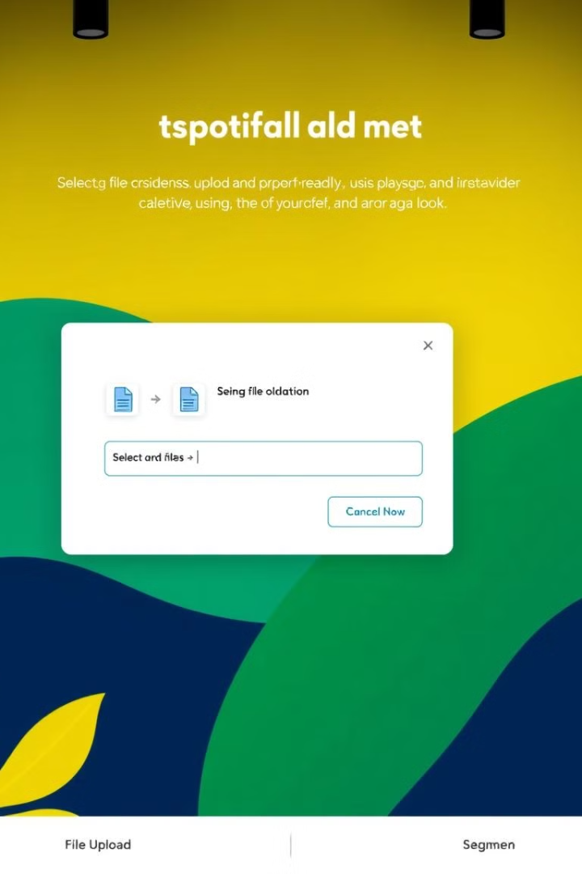


File Upload Feature
Backend Integration
We’ll set up file storage using options like Amazon S3, Google Cloud Storage, or a local file system integrated with Spring Boot.
Frontend Implementation
React will include a file input component for uploading files, which will be sent to the backend via secure API endpoints.

Slide 6
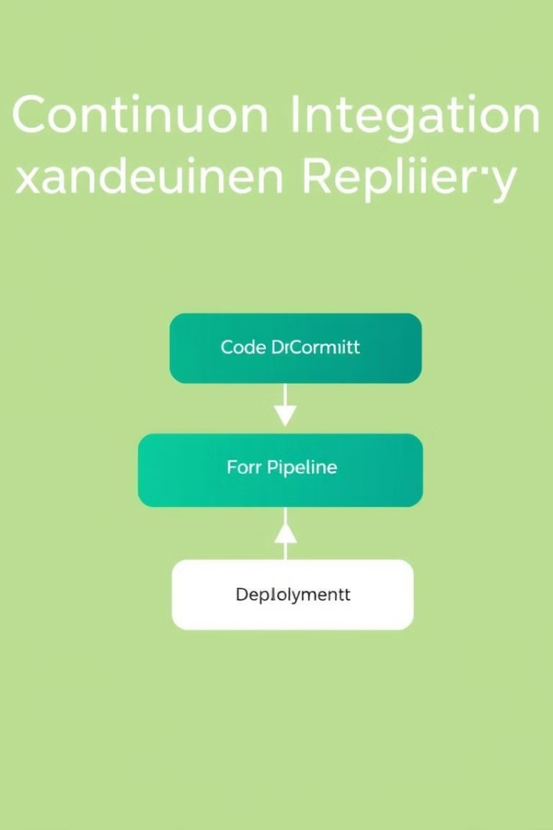
DevOps and Automation
1
GitHub Actions
Runs backend tests whenever code is merged into the main branch.
2
Docker Container Update
If all tests pass, the backend’s Docker container is updated automatically.
3
Continuous Deployment
Ensures the latest version is always live with minimal manual intervention.

Slide 7

Future Plans
Security Enhancements
UI/UX Improvements
Implement refresh tokens to enhance authentication security and user experience.
Refine the design for both the web and mobile apps to ensure a more intuitive and visually appealing experience.
Mobile Development
Implement task management features tailored for managers and optimized designs for better usability on mobile devices.

Slide 8

Conclusion
To summarize, we’ve made significant progress with JWT-based authentication, task management, and an automated deployment pipeline. We’re also developing a mobile app for managers and planning to integrate file upload functionality in the near future. Thank you for your attention. We’d love to hear your feedback or suggestions as we continue to develop and enhance this project!

